Slide 1
Application-agnostic Data Collection Strategies for AI at the Edge
Henry Abrahamson, Yongho Kim
September 2025

Slide 2
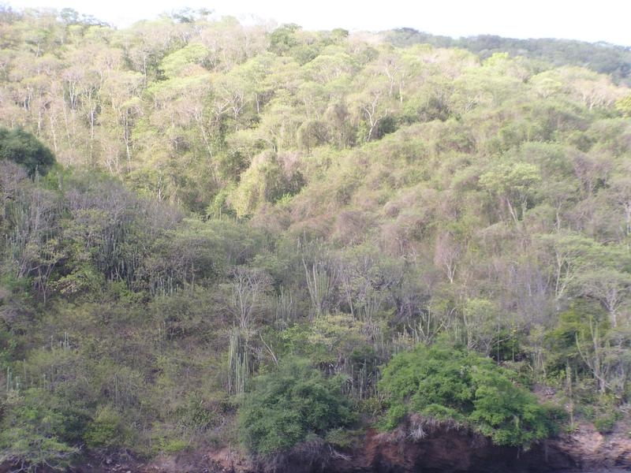
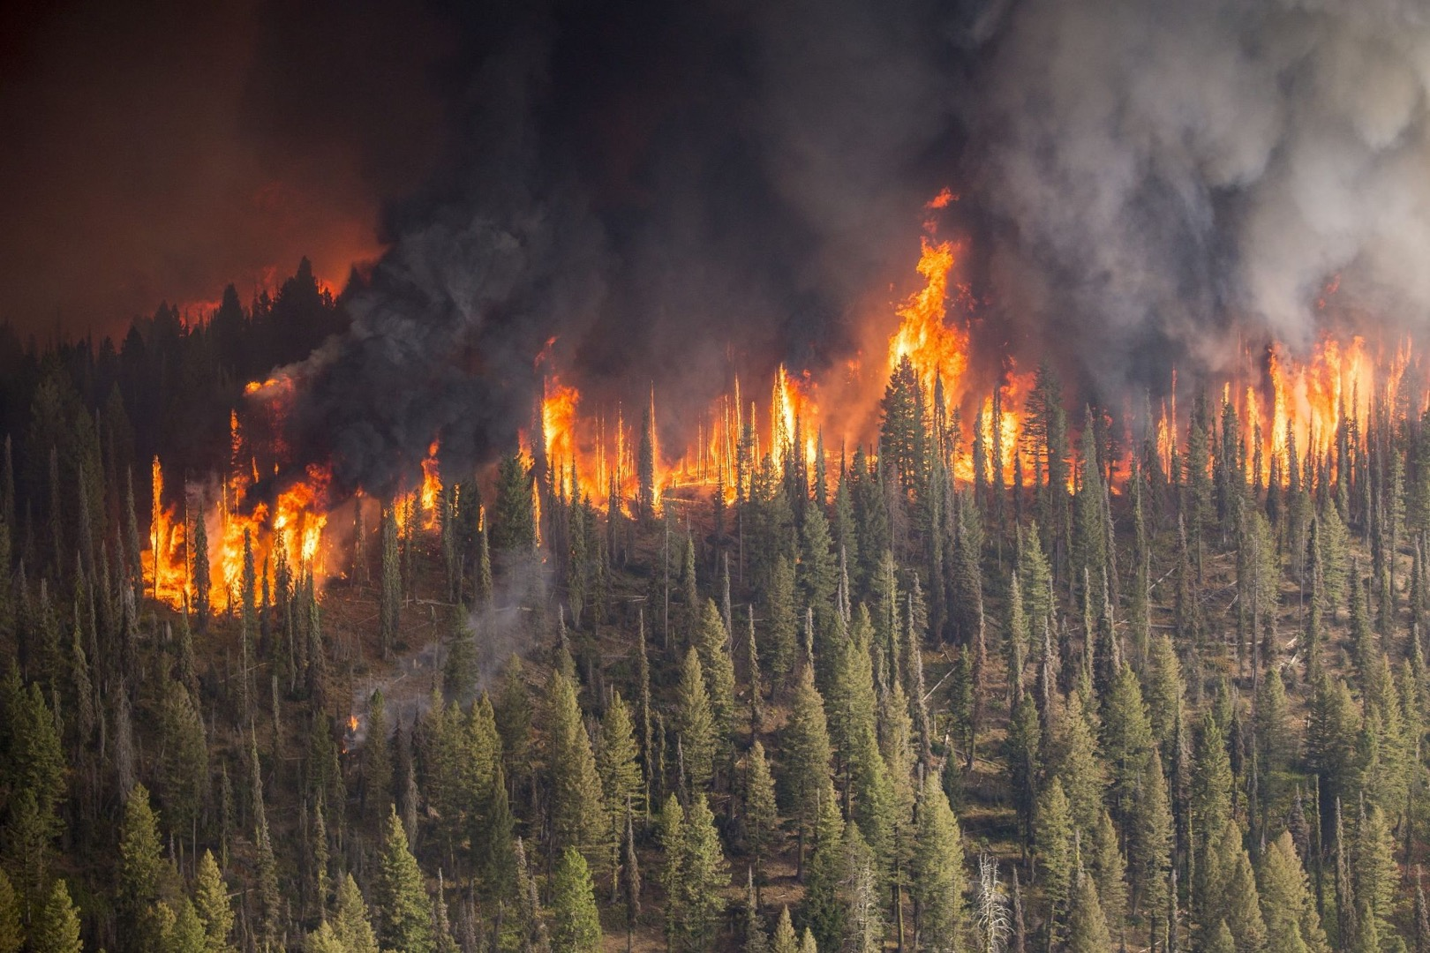
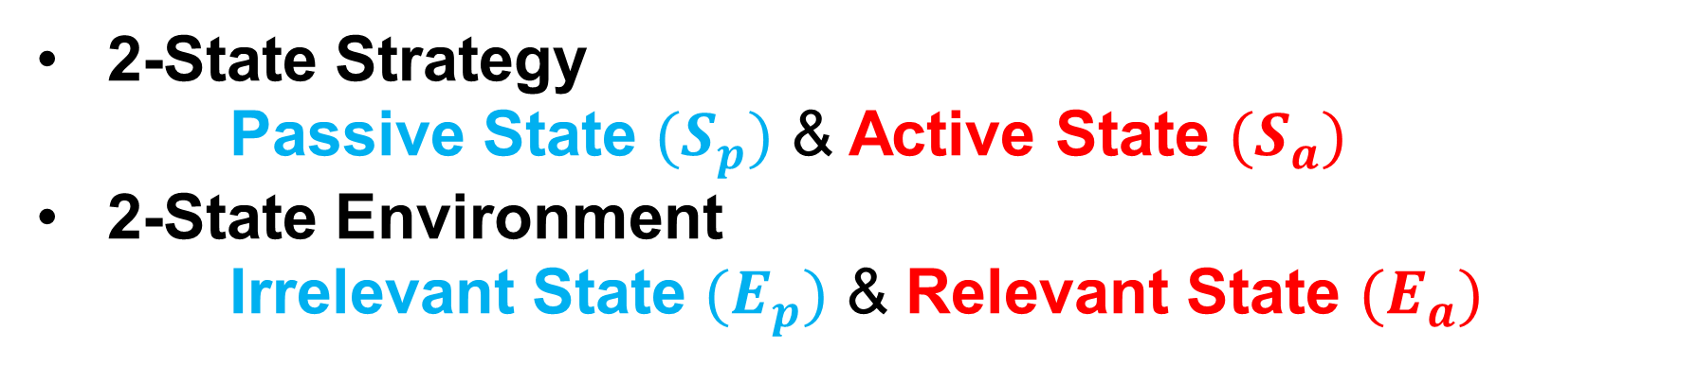
Current Strategy & Environment Model
2-State Strategy Passive State $(S_{p})$ & Active State $(S_{a})$
2-State Environment Irrelevant State $(E_{p})$ & Relevant State $(E_{a})$
Passive / Irrelevant Sensing
Active / Relevant Sensing

Slide 3
Current Strategy & Environment Model
2-State Strategy Passive State $(S_{p})$ & Active State $(S_{a})$
2-State Environment Irrelevant State $(E_{p})$ & Relevant State $(E_{a})$
Passive / Irrelevant Sensing
Active / Relevant Sensing

Slide 4
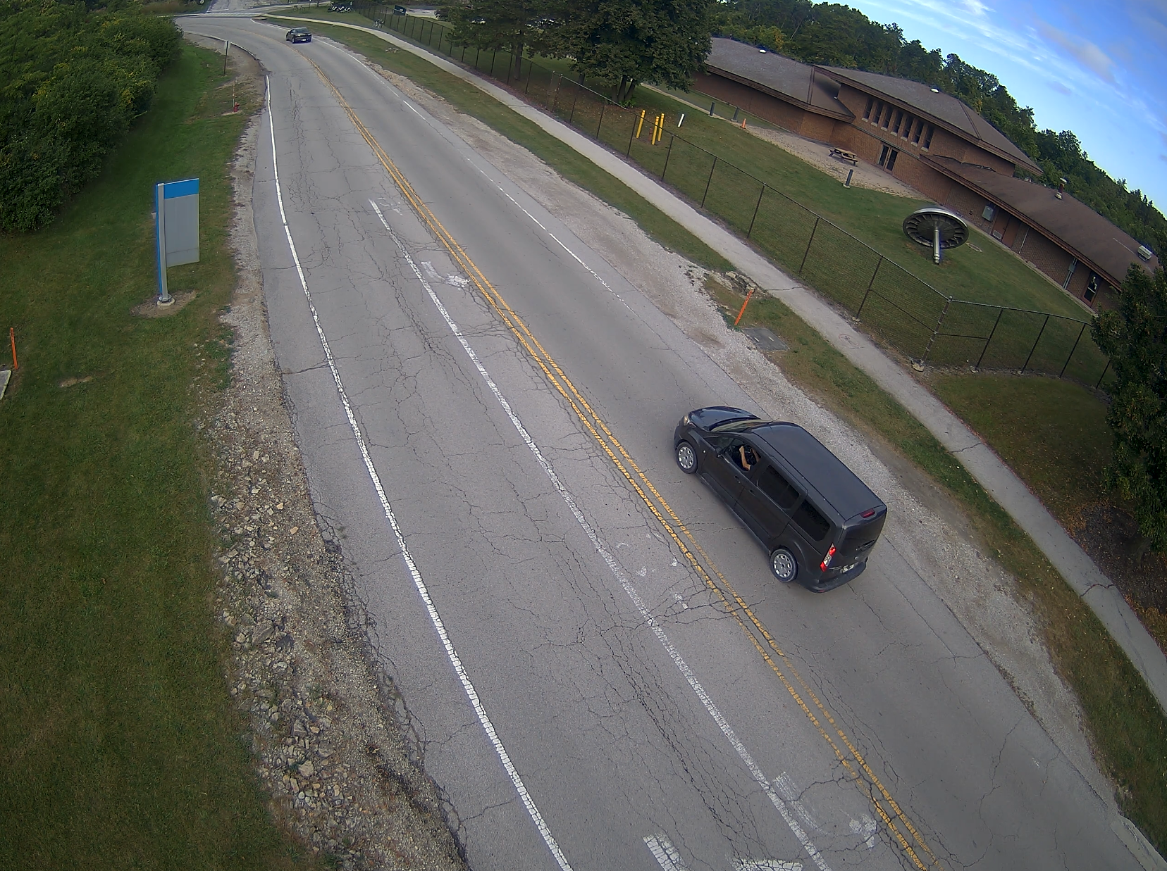
Environment Specifics
Video gathered from the Sage node by the Argonne entrance
Sampled frames for images
Irrelevant Data has no cars on the road
Relevant data has cars on the road
Simulation runs at one time step per minute, for 600 steps

Slide 5
Strategy Specifics
Passive state: YOLO (object detection)
1 CPU for 1 minute
Active state: YOLO + Moondream (Image -> Natural Language Description)
1 CPU for 10 minutes
YOLO detects no cars when Moondream finishes
Passive / Irrelevant Sensing
Active / Relevant Sensing
YOLO detects a car
Passive cost: 1 CPUmin per time step
Active cost: 2 CPUmin per time step

Slide 6
Results:
Comparing against a naïve, nonadaptive strategy that runs Moondream every 10 minutes (with / without YOLO):
Metric | Just Moondream | Moondream + YOLO | Adaptive Strategy
Uses of Moondream | 60 | 60 | 27
CPU Usage (CPUmin) | 600 | 1200 | 870
# of Relevant Images Analyzed by Moondream | 15 | 15 | 27
Adaptive strategy detects a car with YOLO
Naïve strategy starts Moondream
on this image
Adaptive strategy runs Moondream on this image
Naïve strategy starts Moondream
on this image
t = 0
Car Sighting Event
t = 10
t = 5

